Slide 1
Lecture 2 Greedy Algorithms

Slide 2
Introduction
Definition:
A greedy algorithm is an algorithm in which at each stage a locally optimal choice is made.
Characteristics:
1. Greedy-choice property: A global optimum can be arrived at by selecting a local optimum.
2. Optimal substructure: An optimal solution to the problem contains an optimal solution to subproblems.
Greedy algorithms are usually extremely efficient, but they can only be applied to a small number of problems.

Slide 3
Introduction
贪心算法总是作出在当前看来最好的选择。也就是说贪心算法并不从整体最优考虑，它所作出的选择只是在某种意义上的局部最优选择。当然，希望贪心算法得到的最终结果也是整体最优的。虽然贪心算法不能对所有问题都得到整体最优解，但对许多问题它能产生整体最优解。如单源最短路经问题，最小生成树问题等。在一些情况下，即使贪心算法不能得到整体最优解，其最终结果却是最优解的很好近似。

Slide 4
Activity Selection Problem
Let S = {1, 2, . . . , n} be the set of activities that compete for a resource. Each activity i has its starting time s_{i} and finish time f_{i} with s_{i} ≤ f_{i}, namely, if selected, i takes place during time [s_{i}, f_{i}). No two activities can share the resource at any time point. We say that activities i and j are compatible if their time periods are disjoint.
The activity selection problem is the problem of selecting the largest set of mutually compatible activities.

Slide 5
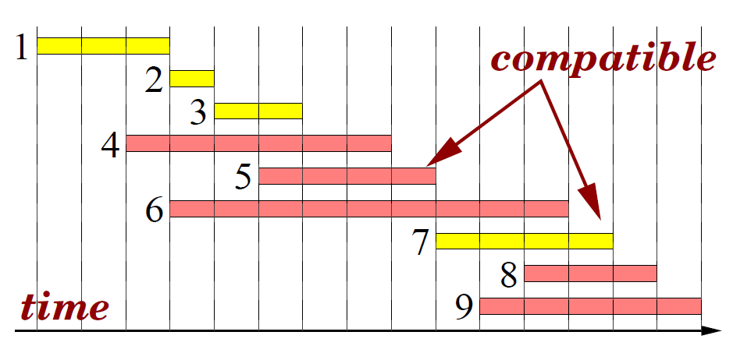
Activity Selection Problem

Slide 6
Activity Selection Problem
Greedy template. Consider activities in some natural order. Take each activity provided it's compatible with the ones already taken.
[Earliest start time] Consider jobs in ascending order of s_{i}.
[Earliest finish time] Consider jobs in ascending order of f_{i}.
[Shortest interval] Consider jobs in ascending order of f_{i}-s_{i}.
[Fewest conflicts] For each job i, count the number of conflicting jobs c_{i}. Schedule in ascending order of c_{i}.

Slide 7
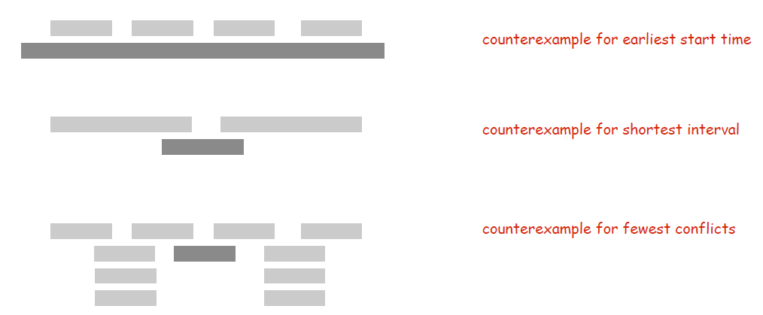
Activity Selection Problem
Counterexamples:

Slide 8
Activity Selection Problem
Greedy algorithm. Consider jobs in increasing order of finish time. Take each job provided it's compatible with the ones already taken.
Implementation. O(nlogn)+O(n)
Sort activities by finish times so that f₁ <= f₂ <= ... <= f_{n}
A = Ф
for j = 1 to n {
if (activity j compatible with A) A = A ∪ {j}
}
return A

Slide 9
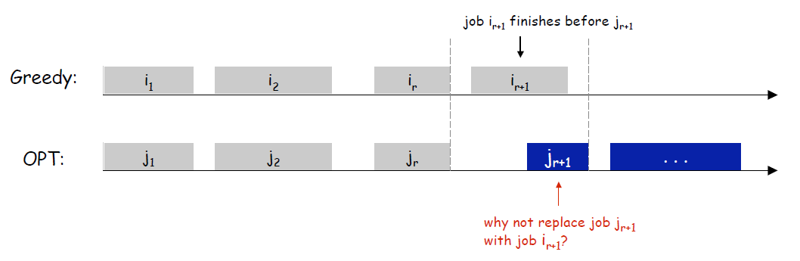
Activity Selection Problem
Theorem: Greedy algorithm is optimal for the activity selection problem.
Proof: (by contradiction)
Assume greedy is not optimal.
Let i1, i2, ... ik denote set of jobs selected by greedy.
Let j1, j2, ... jm denote set of jobs in the optimal solution with i₁ = j₁, i₂ = j₂, ..., i_{r} = j_{r} for the largest possible value of r.

Slide 10
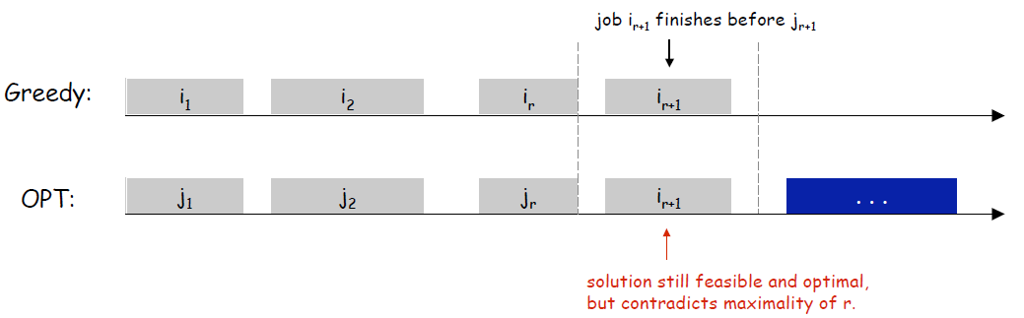
Activity Selection Problem
Theorem: Greedy algorithm is optimal for the activity selection problem.
Proof: (by contradiction)
Assume greedy is not optimal.
Let i1, i2, ... ik denote set of jobs selected by greedy.
Let j1, j2, ... jm denote set of jobs in the optimal solution with i₁ = j₁, i₂ = j₂, ..., i_{r} = j_{r} for the largest possible value of r.

Slide 11
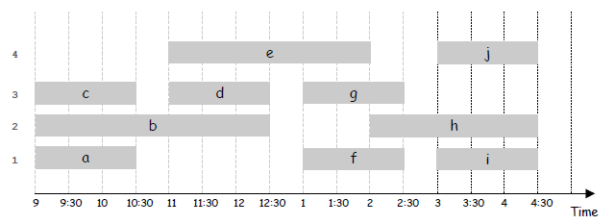
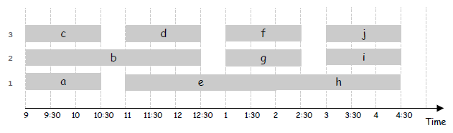
Interval Partitioning Problem
Lecture j starts at s_{j} and finishes at f_{j}.
Goal: find minimum number of classrooms to schedule all lectures so that no two occur at the same time in the same room.

Slide 12
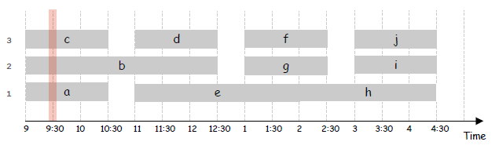
Interval Partitioning Problem
Definition. The depth of a set of open intervals is the maximum number that contain any given time.
Key observation. Number of classrooms needed ≥ depth.
Question. Does there always exist a schedule equal to depth of intervals?

Slide 13
Interval Partitioning Problem
Greedy algorithm. Consider lectures in increasing order of start time: assign lecture to any compatible classroom.
Implementation. O(n log n).
For each classroom k, maintain the finish time of the last job added.
Keep the classrooms in a priority queue.
Sort intervals by starting time so that s₁ ≤ s₂ ≤ ... ≤ s_{n}.
d ← 0
for j = 1 to n {
if (lecture j is compatible with some classroom k)
schedule lecture j in classroom k
else
allocate a new classroom d + 1
schedule lecture j in classroom d + 1
d ← d + 1
}

Slide 14
Interval Partitioning Problem
Theorem. Greedy algorithm is optimal.
Proof.
Let d = number of classrooms that the greedy algorithm allocates.
Classroom d is opened because we needed to schedule a job, say j, that is incompatible with all d-1 other classrooms.
These d jobs each end after s_{j}.
Since we sorted by start time, all these incompatibilities are caused by lectures that start no later than s_{j}.
Thus, we have d lectures overlapping at time s_{j} + ε.

Slide 15

Fractional Knapsack Problem
We have n objects and a knapsack. The i-th object has positive weight w_{i} and positive value v_{i}. The knapsack capacity is C. We wish to select a set of proportions of objects to put in the knapsack so that the total values is maximum and without breaking the knapsack.
Example:
n = 5, C = 100

Slide 16


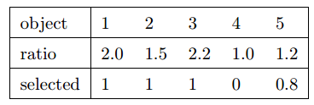
Fractional Knapsack Problem
Greedy template.
[Select always the lighter object] Total selected weight 100 and total value 156.
[Select always the most valuable object] Total selected weight 100 and total value 146.
[Select always the object with highest ratio value/weight] Total selected weight 100 and total value 164.

Slide 17
Fractional Knapsack Problem
Theorem: The greedy algorithm that always selects the object with better ratio value/weight always finds an optimal solution to the Fractional Knapsack problem.
Proof:
Assume that the objects are {1, ... , n} and that
Let X = (x₁, . . . , x_{n}) be the solution computed by the greedy algorithm.
If x_{i} = 1 for all i, the solution is optimal. Otherwise, let j be the smallest value for which x_{j} < 1. According to the algorithm we have: If i < j then x_{i} = 1, and if i > j then x_{i} = 0.
Furthermore,

Slide 18
Fractional Knapsack Problem
Let Y = (y₁, ... , y_{n}) be any feasible solution, we have
so,
Let V(Z) denotes the total value of a feasible solution.
If i<j, x_{i}=1, then x_{i}-y_{i}>=0 and v_{i}/w_{i}>=v_{j}/w_{j}, we have
If i>j, x_{i}=0, then x_{i}-y_{i}<=0 but v_{i}/w_{i}<=v_{j}/w_{j}, we also have

Slide 19
Fractional Knapsack Problem
Plugging the inequality we have,
Therefore, X is an optimal solution.

Slide 20
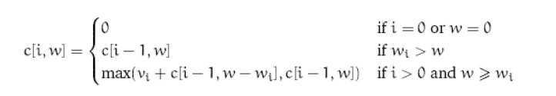
0-1 Knapsack Problem

Slide 21
Huffman Coding
A nice application of a greedy algorithm is found in an approach to data compression called Huffman coding.
Suppose that we have a large amount of text that we wish to store on a computer disk in an efficient way. The simplest way to do this is simply to assign a binary code to each character, and then store the binary codes consecutively in the computer memory.
The ASCII system for example, uses a fixed 8-bit code to represent each character. Storing n characters as ASCII text requires 8n bits of memory.

Slide 22
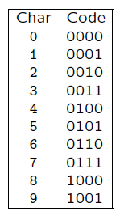
Huffman Coding
Let C be the set of characters we are working with. To simplify things, let us suppose that we are storing only the 10 numeric characters 0, 1, . . ., 9. That is, set C = {0, 1, … , 9}.
A fixed length code to store these 10 characters would require at least 4 bits per character. For example we might use a code like this:
However in any non-random piece of text, some characters occur far more frequently than others, and hence it is possible to save space by using a variable length code where the more frequently occurring characters are given shorter codes.

Slide 23
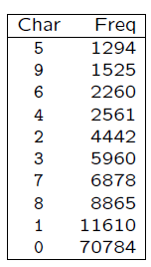
Huffman Coding
Consider the following data, which is taken from a Postscript file.
Notice that there are many more occurrences of 0 and 1 than the other characters.

Slide 24
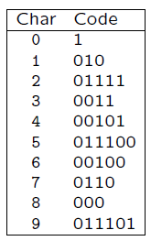
Huffman Coding
What would happen if we used the following code to store the data rather than the fixed length code?
To store the string 0748901 we would get 0000011101001000100100000001 using the fixed length code and 10110001010000111011010 using the variable length code.

Slide 25
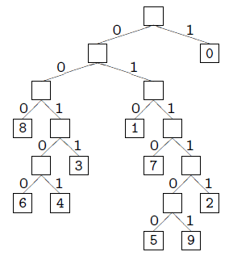
Huffman Coding
In order to be able to decode the variable length code properly it is necessary that it be a prefix code — that is, a code in which no codeword is a prefix of any other codeword.
Decoding such a code is
done using a binary tree.

Slide 26
Huffman Coding
Now assign to each leaf of the tree a value, f(c), which is the frequency of occurrence of the character c represented by the leaf.
Let d_{T}(c) be the depth of character c’s leaf in the tree T.
Then the number of bits required to encode a file is
which we define as the cost of the tree T.

Slide 27
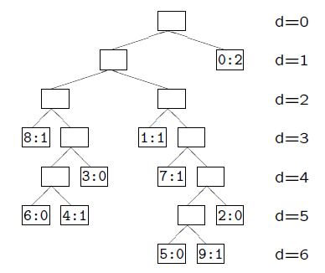
Huffman Coding
For example, the number of bits required to store the string 0748901 can be computed from the tree T:
giving B(T) = 2×1+1×3+1×3+1×4+1×5+1×6 = 23.
Thus, the cost of the tree T is 23.

Slide 28
Huffman Coding
A tree representing an optimal code for a file is always a full binary tree (note, full v.s. complete, perfect) — namely, one where every node is either a leaf or has precisely two children.
Therefore if we are dealing with an alphabet of s symbols we can be sure that our tree has precisely s leaves and s−1 internal nodes, each with two children.
Huffman invented a greedy algorithm to construct such an optimal tree. The resulting code is called a Huffman code for that file.

Slide 29

Huffman Coding
Huffman’s algorithm. The algorithm starts by creating a forest of s single nodes, each representing one character, and each with an associated value, being the frequency of occurrence of that character. These values are placed into a priority queue (implemented as a linear array).
Then repeat the following procedure s − 1 times:
Remove from the priority queue the two nodes L and R with the lowest values, and create a internal node of the binary tree whose left child is L and right child R.
Compute the value of the new node as the sum of the values of L and R and insert this into the priority queue.

Slide 30
Huffman Coding
Huffman算法用最小堆实现优先队列Q。初始化优先队列需要O(n)计算时间，由于最小堆的removeMin和insert运算均需O(logn)时间，n－1次的合并总共需要O(nlogn)计算时间。因此，关于n个字符的哈夫曼算法的计算时间为O(nlogn) 。

Slide 31
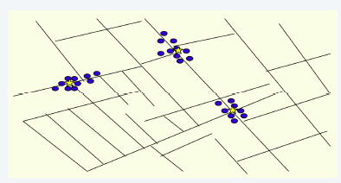
Single-link Clustering
Given a set U of n objects labeled p₁, …, p_{n}, partition into clusters so that objects in different clusters are far apart.
Applications.
Routing in mobile ad hoc networks.
Document categorization for web search.
Similarity searching in medical image databases
Skycat: cluster 10⁹ sky objects into stars, quasars, galaxies.
􀉾...

Slide 32
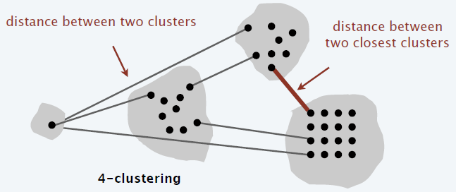
Single-link Clustering
k-clustering: Divide objects into k non-empty groups.
Distance function: Numeric value specifying "closeness" of two objects.
Spacing: Minimum distance between any pair of points in different clusters.
Goal: Given an integer k, find a k-clustering of maximum spacing.

Slide 33
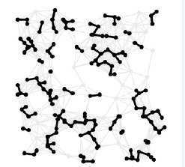
Single-link Clustering
“Well-known” algorithm in science literature for single-linkage k-clustering:
Form a graph on the node set U, corresponding to n clusters.
Find the closest pair of objects such that each object is in a different cluster, and add an edge between them.
Repeat n – k times until there are exactly k clusters.
This procedure is precisely Kruskal's algorithm.
Alternative. Find an MST and delete the k – 1 longest edges.

Slide 34
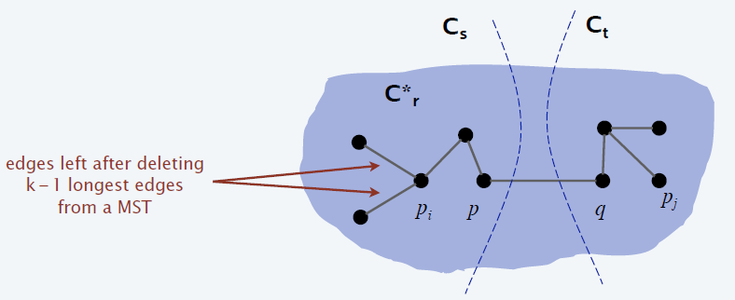
Single-link Clustering
Theorem: Let C* denote the clustering C*₁, …, C*_{k} formed by deleting the k – 1 longest edges of an MST. Then, C* is a k-clustering of max spacing.
Proof: Let C denote some other clustering C₁, …, C_{k}.
The spacing of C* is the length d* of the (k – 1)-st longest edge in MST.

Slide 35
Single-link Clustering
Let p_{i} and p_{j} be in the same cluster in C*, say C*_{r} , but different clusters in C, say C_{s} and C_{t}.
Some edge (p, q) on p_{i} ~ p_{j} path in C*_{r} spans two different clusters in C.
Edge (p, q) has length ≤ d* since it wasn't deleted.
Spacing of C is ≤ d* since p and q are in different clusters.

Slide 36
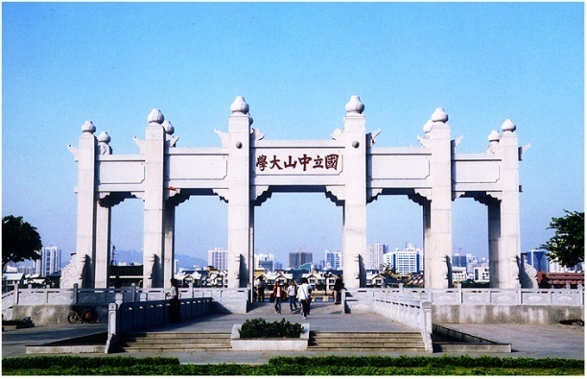
Thank you!

